Slide 1
Introduction to Android Testing

Slide 2
App Testing
Testing your app is an integral part of the app development process
By running tests against your app consistently, you can verify your app's correctness, functional behavior, and usability before you release it publicly
Best practice: Automate tests and integrate them into a CI/CD pipeline for continuous feedback

Slide 3
Advantages of Testing
Testing also provides you with the following advantages:
Rapid feedback on failures
Early failure detection in the development cycle
Safer code refactoring, letting you optimise code without worrying about regressions
Stable development velocity, helping you minimise technical debt
Best practice: Write and run tests from the start to catch issues early

Slide 4
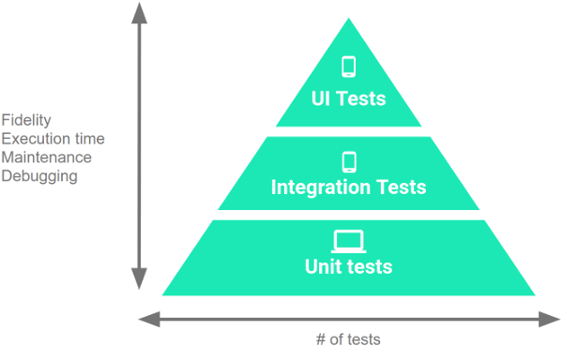
Types of Testing in Android
There are three types of tests:
Unit Tests
Instrumentation Tests
UI Tests

Slide 5
Unit Test
Unit tests are the most basic yet important tests to check the smallest components like methods and classes
They run on your computer to test some part of your code (Raw Java/Kotlin code)
It doesn’t need an emulator/device
These tests are more focused on testing your code logic,
What a method does?
Does the method do it right?
Is the sequence of code correct?
They run very fast
Most popular libraries to do Unit tests are JUnit and Mockito

Slide 6
Unit Test
Best Practice: Keep unit tests focused on a single method or class, avoiding dependencies on external systems
Use JUnit for structuring tests and Mockito for mocking dependencies to keep tests independent and efficient

Slide 7
Example of Junit & Mockito
public class UserRepository {
private final UserDataSource userDataSource;
public UserRepository(UserDataSource userDataSource) {
this.userDataSource = userDataSource;
}
public String getUserName(int userId) {
return userDataSource.getUserById(userId).getName();
}
}
public class UserRepositoryTest {
@Mock
private UserDataSource mockDataSource; // Mocking the dependency
private UserRepository userRepository;
@Before
public void setUp() {
MockitoAnnotations.initMocks(this); // Initialize mocks
userRepository = new UserRepository(mockDataSource);
}
@Test
public void testGetUserName_ReturnsCorrectName() {
// Arrange: Mock behavior of DataSource
User mockUser = new User(1, "Alice");
when(mockDataSource.getUserById(1)).thenReturn(mockUser);
// Act: Call method
String userName = userRepository.getUserName(1);
// Assert: Verify expected behavior
assertEquals("Alice", userName);
}

Slide 8
Instrumentation Test
Instrumentation is an Android Framework that provides additional monitoring and control over the app under test
It installs the test package as a separate APK as part of a connected android test Gradle Task
The Instrumentation tests test Android Specific components like Activity, Fragments, ViewModels, life cycles, …
They run on real devices/ emulators to get access to the Android Framework and be able to test the Android-specific components
Most popular libraries to do Instrumentation Tests are Robolectric

Slide 9
UI Test
Simulates what a user might be doing with your application like pressing a button, scrolling through views, entering texts
It also does that at a much faster speed than a normal user which will do and help you find out which part of your UI might break your app
They need a real device/emulator
The most popular library to do UI Tests is Espresso

Slide 10
Plan for scaling up your app
Scaling up, you might find it necessary to:
fetch data from a server,
interact with the device's sensors,
access local storage, or
render complex user interfaces
The versatility of your app demands a comprehensive testing strategy

Slide 11
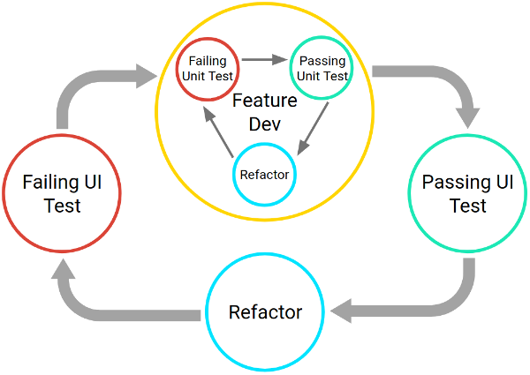
Plan for scaling up your app
Create and test code iteratively
Use Test Driven Development (TDD)

Slide 12
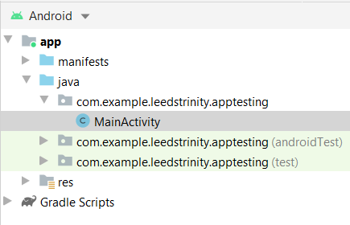
Understanding the Android Project View
A typical project in Android Studio contains two directories in which you place tests
The androidTest directory should contain the tests that run on real or virtual devices such tests include integration tests (instrumentation tests), end-to-end tests (UI tests), and other tests where the JVM alone cannot validate your app's functionality
The test directory should contain the tests that run on your local machine, such as unit tests

Slide 13
Run your Tests on Different Devices
Consider tradeoffs of running tests on different types of devices:
Real devices
Virtual devices (such as emulators in Android Studio)
Simulated devices (such as Robolectric)

Slide 14
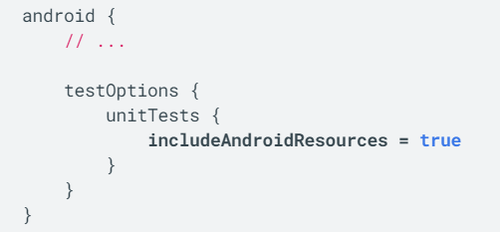
Write Your Tests
app/build.gradle
Write small unit tests
The small tests should be highly-focused unit tests that validate the functionality of each class within your app
As you add and change methods within a particular class, create and run unit tests against them
If your tests rely on resources, your unit tests must access compiled versions of your resources, allowing the tests to run more quickly and accurately

Slide 15

Local Unit Tests
Use the AndroidX Test APIs whenever possible so that your unit tests can run on a device or emulator
For tests that always run on a JVM-powered development machine, you can use Robolectric
Robolectric simulates the runtime for Android 4.1 (API level 16) or higher and provides community-maintained fakes called shadows
This functionality allows you to test code that depends on the framework without needing to use an emulator or mock objects
Robolectric supports the following aspects of the Android platform:
Component lifecycles
Event loops
All resources

Slide 16
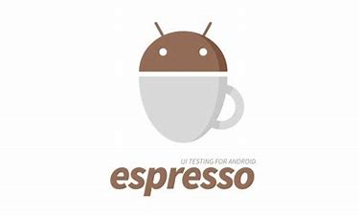
Write Your Tests
Write medium tests
In addition to testing each unit of your app by running small tests, you should validate your app's behavior from the module level
To do so, write medium tests, which are integration tests that validate the collaboration and interaction of a group of units

Slide 17
Medium Tests
Medium Tests test the following:
Interactions between a view and view model, such as testing a Fragment object, validating layout XML, or evaluating the data-binding logic of a ViewModel object
Tests in your app's repository layer, which verify that your different data sources and data access objects (DAOs) interact as expected
Vertical slices of your app, testing interactions on a particular screen. Such a test verifies the interactions throughout the layers of your app's stack
Multi-fragment tests that evaluate a specific area of your app

Slide 18
Use Espresso when running instrumented & UI medium tests
Espresso helps keep tasks synchronised as you perform UI interactions similar to the following on a device or on Robolectric:
Performing actions on View objects
Assessing how users with accessibility needs can use your app
Locating and activating items within RecyclerView and AdapterView objects
Validating the state of outgoing intents
To learn more about these interactions and how to use them in your app's tests, see the Espresso guide

Slide 19
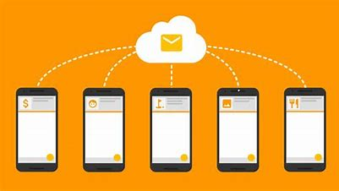
Write Your Tests
Write big tests
Although it's important to test each class and module within your app in isolation, it's just as important to validate end-to-end workflows that guide users through multiple modules and features
These types of tests form unavoidable bottlenecks in your code, but you can minimise this effect by validating an app that's as close to the actual, finished product as possible
Typically, it's better to test your app on an emulated device or a cloud-based service like Firebase Test Lab, rather than on a physical device, as you can test multiple combinations of screen sizes and hardware configurations more easily and quickly

Slide 20
Firebase Test Lab
Get started testing for Android with Firebase Test Lab

Slide 21
Resources
Test apps on Android | Android Developers
Espresso | Android Developers
Robolectric
Get started testing for Android with Firebase Test Lab

